Slide 1
DRAMatic Speedup: Accelerating HE Operations on a Processing-in-Memory System
Niklas Klinger, Jonas Sander, Peterson Yuhala, Pascal Felber, Thomas Eisenbarth
University of Lübeck and University of Neuchâtel, Switzerland
Notes:
I will present our paper “DRAMatic Speedup: Accelerating HE Operations on a Processing-in-Memory System”.
We will start with a motivation for FHE and one of its main applications, which is Cloud Computing.

Slide 2


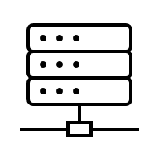

Scenario: Cloud Computing
1. Send x
A
C
2. Compute
y = f(x)
3. Send back y
Notes:
We have Alice and a Cloud server… does some computation
Server can read data.
Transport encryption is not enough, e.g. TLS.
Server needs to decrypt data for computation.
Server can’t modify TLS message (Integrity).

Slide 3
Cloud Computing using FHE
1. (pk, sk) = KeyGen()
2. Send pk, m = Enc(pk, x)
A
C
3. Compute
m‘ = Eval(pk, f, m)
5. Decrypt
y = Dec(sk, m‘)
4. Send back m‘
Data stays encrypted. C cannot read it.
Notes:
With FHE it is possible to operate on encrypted data (Eval func).
Encryption and Decryption is only done by Alice.
In the paper, we focus on the server side: Computing on encrypted data.
Specifically using UPMEM PIM (special hardware).

Slide 4
Contributions of DRAMatic
Implement HE operations on UPMEM PIM
  BGV multiplication
  number-theoretic transforms (NTT)
334 times faster than previous work
  And with larger parameter sizes (secure in practical use-cases)
Compared to concurrent work:
  Better scaling with parallelism (number of DPUs)
  Custom optimized multiplication routines
  More operations (not only NTT)
We close the gap to CPU implementation (SEAL)
Power measurements and comparisons
Notes:
If we want to accelerate FHE, we need to first understand how it works…

Slide 5
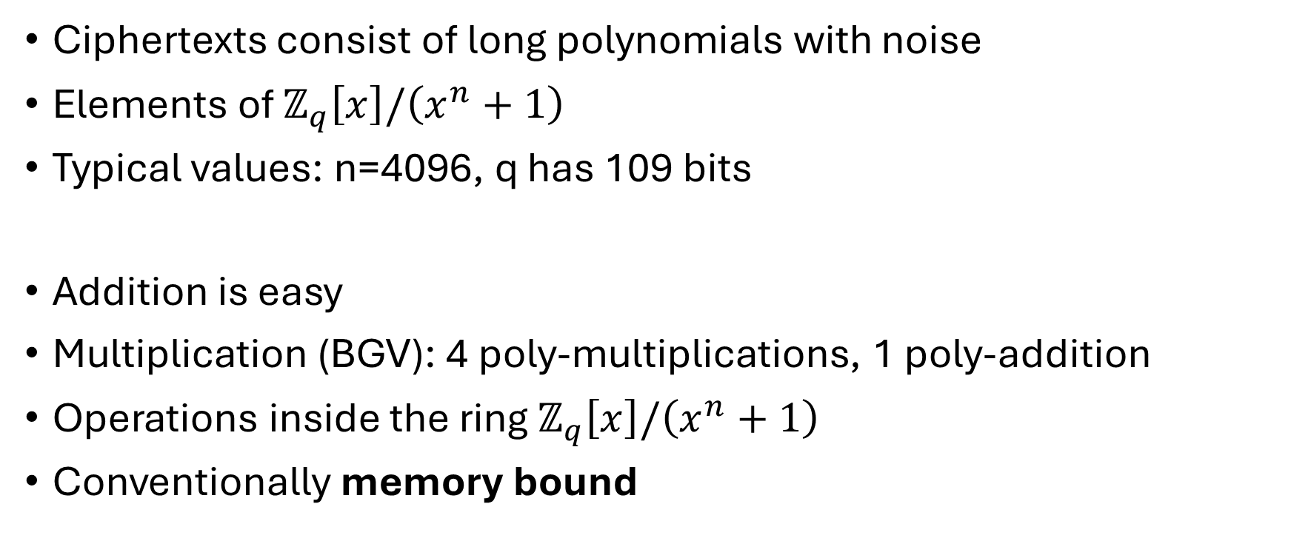
FHE in Practice (RLWE Schemes)
Ciphertexts consist of long polynomials with noise
Elements of $ℤ_{q}\left[x\right]/\left(x^{n}+1\right)$
Typical values: n=4096, q has 109 bits
Addition is easy
Multiplication (BGV): 4 poly-multiplications, 1 poly-addition
Operations inside the ring $ℤ_{q}\left[x\right]/\left(x^{n}+1\right)$
Conventionally memory bound
Notes:
In the paper, we focus on RLWE schemes.
In these schemes…

Slide 6
Processing-in-Memory (PIM)
Alternative hardware architecture
Memory and compute on same chip
Very high bandwidth, scales with processing power
UPMEM PIM: custom RISC processors (DPUs) on DIMMs
Suitable for accelerating FHE?
Notes:
Now, to PIM.
Let‘s take a quick look at the UPMEM PIM hardware…

Slide 7
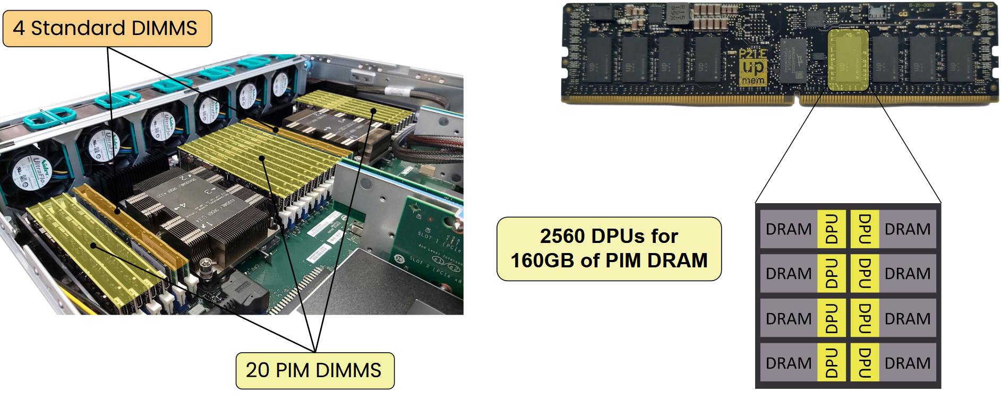
UPMEM PIM
Source: UPMEM, “Session welcome and aims”, ABUMPIMP 2024 at Euro-Par 2024. Retrieved from https://www.upmem.com/abumpimp-2024/
Notes:
Next slide: explain MRAM

Slide 8
UPMEM PIM
Source: UPMEM, “Session welcome and aims”, ABUMPIMP 2024 at Euro-Par 2024. Retrieved from https://www.upmem.com/abumpimp-2024/
Notes:
64 MB slices called MRAM (Main RAM)

Slide 9
UPMEM PIM
Source: UPMEM, “Session welcome and aims”, ABUMPIMP 2024 at Euro-Par 2024. Retrieved from https://www.upmem.com/abumpimp-2024/

Slide 10
DPU Characteristics
Custom 32-bit RISC processors
Every instruction takes 1 cycle, in-order, no speculation, no cache
64 MB MRAM, 64 KB WRAM
Explicit memory management/transfer
No inter-DPU communication (only through CPU)
Only 8x8-bit hardware multiplication
Notes:
Up to 400 MHz. Not fast, but we have a lot of DPUs.

Slide 11
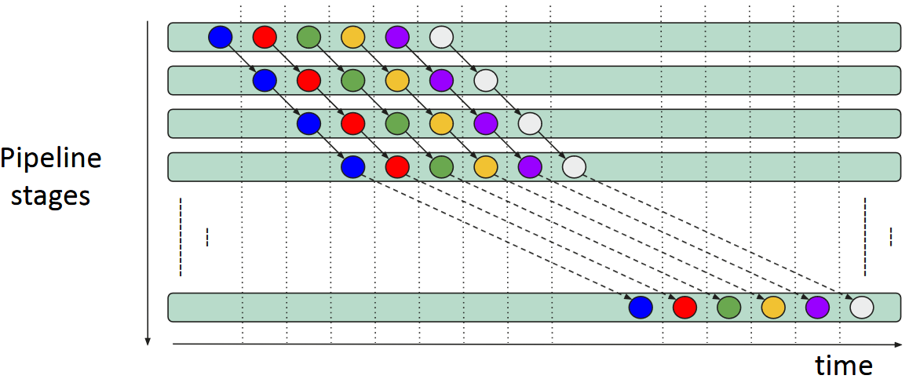
DPU Characteristics: Pipeline
14-stage pipeline, round-robin scheduling (11 threads needed)
Source: UPMEM, “Keynote: UPMEM PIM platform for Data-Intensive Applications”, ABUMPIMP 2024 at Euro-Par 2024.
Retrieved from https://www.upmem.com/abumpimp-2024/
Notes:
Not only parallelism between DPUs, but also inside DPUs.
Colors are threads.
Different threads can‘t have data dependencies.

Slide 12
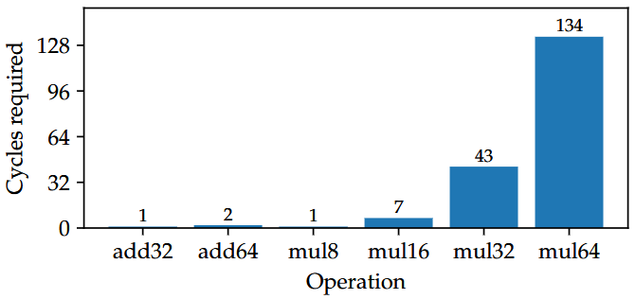
DPU Characteristics: Slow Multiplication
Notes:
Larger multiplications are implemented by the compiler.
Significant slowdown compared to 8x8-bit.
Requires optimisations for use with large polynomials.

Slide 13
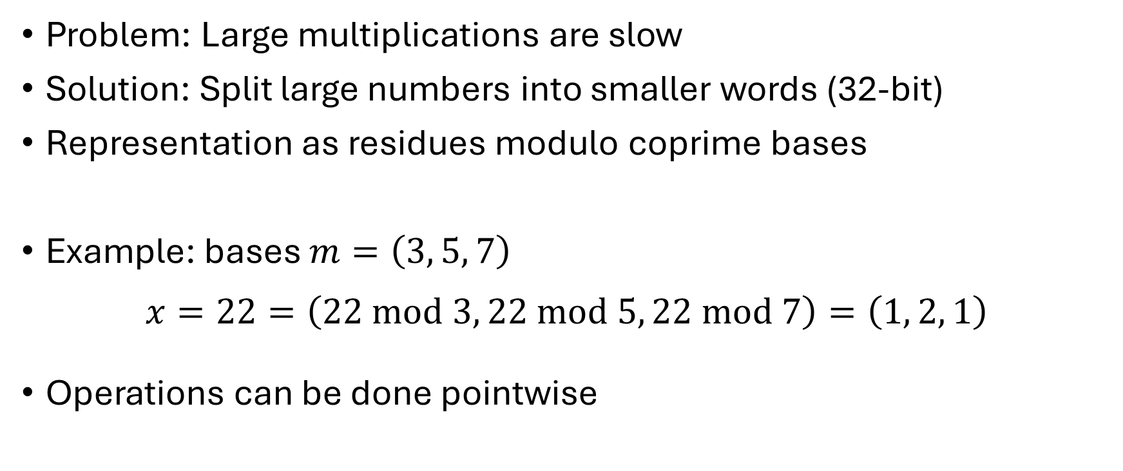
Residue Number System (RNS)
Problem: Large multiplications are slow
Solution: Split large numbers into smaller words (32-bit)
Representation as residues modulo coprime bases
Example: bases $m=\left(3, 5, 7\right)$
$$x=22=\left(22 \text{mod} 3, 22 \text{mod} 5, 22 \text{mod} 7\right)=\left(1, 2, 1\right)$$
Operations can be done pointwise
Notes:
First optimization: RNS.
Examples: Times 2 => (2, 4, 2) = 44

Slide 14
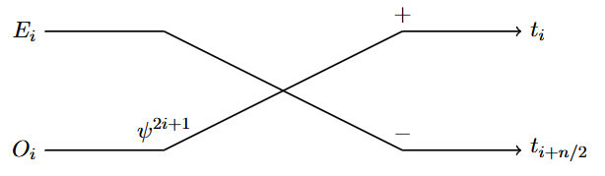
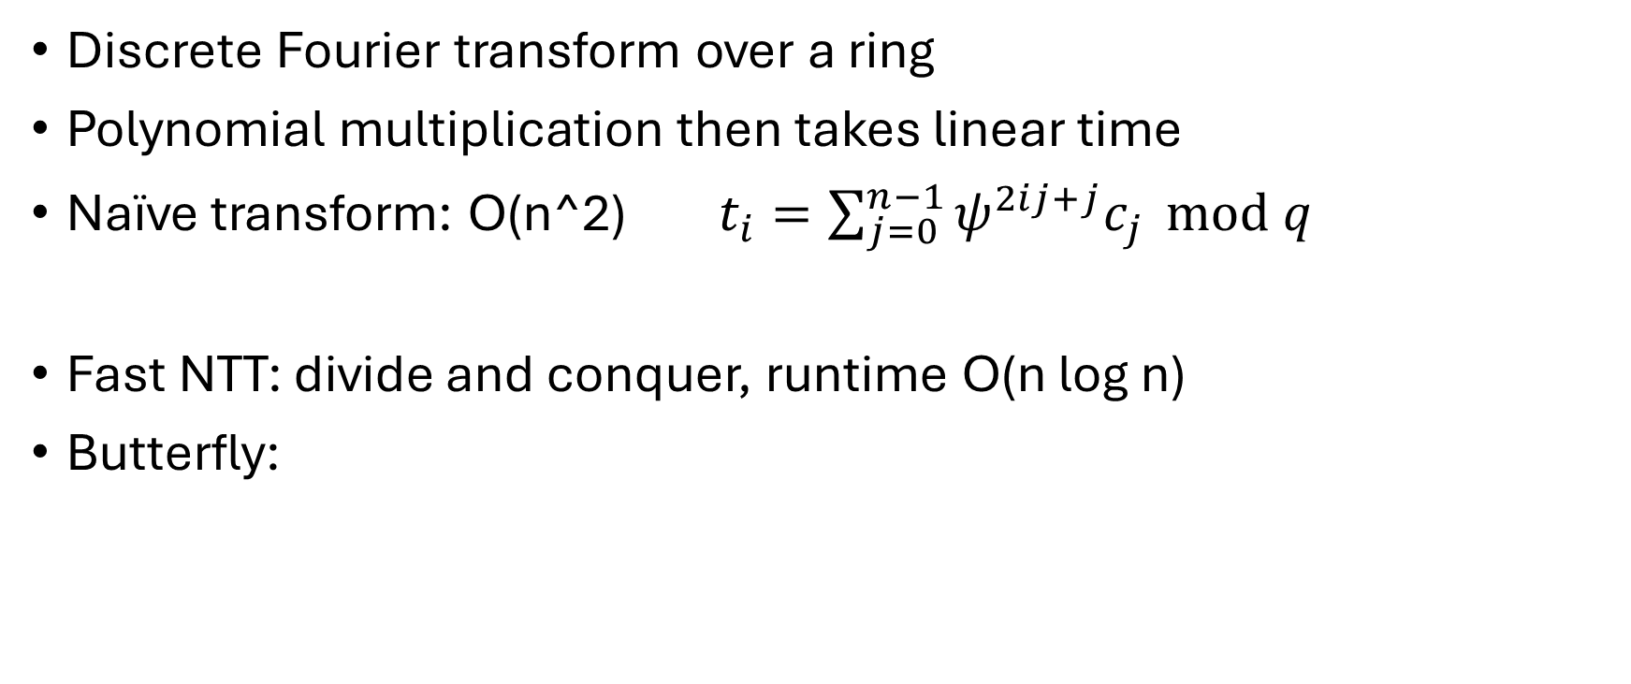
Number-Theoretic Transform (NTT)
Discrete Fourier transform over a ring
Polynomial multiplication then takes linear time
Naïve transform: O(n^2) $t_{i}=\sum_{j=0}^{n−1}{ψ^{2ij+j}c_{j}} \text{mod} q$
Fast NTT: divide and conquer, runtime O(n log n)
Butterfly:
Notes:
Another optimization: NTT.

Slide 15
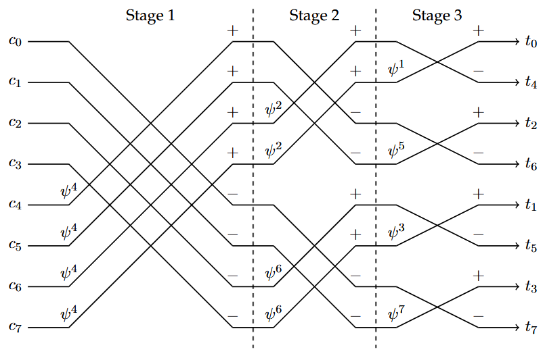
Butterfly Stages in Fast NTT
Output and twiddle factors are in bit-reversed order

Slide 16
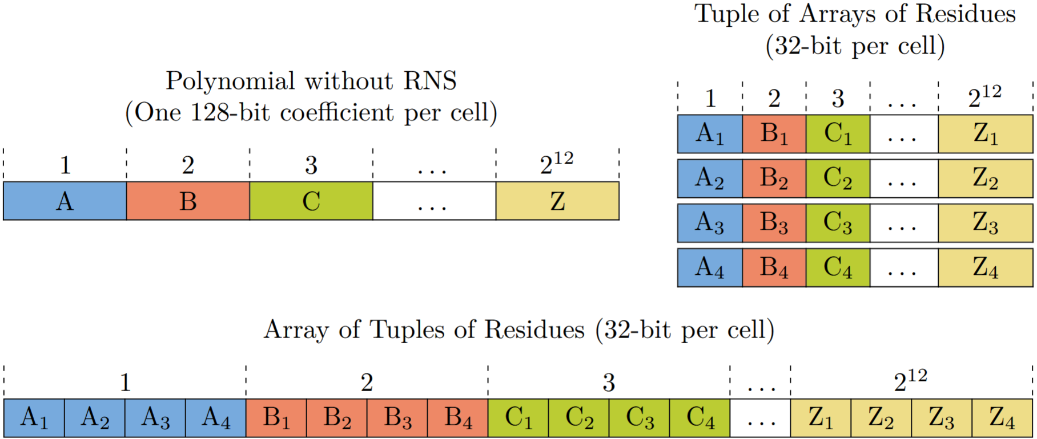
Combining RNS and NTT
Notes:
To combine RNS and NTT, we split the coefficients using RNS and then perform NTT on the groups of residues which share a modulus.
DRAMatic uses the tuple of arrays of residues layout (top right).
Splitting Work over DPUs:
We split the coefficient data over DPUs based on its residues, which allows us to parallelize work (even for single ciphertext pairs) while avoiding inter-DPU communication.
To utilize all DPUs, we must have enough ciphertexts to work on.
One example ciphertext would be split into 4 residue parts => 4 DPUs.

Slide 17
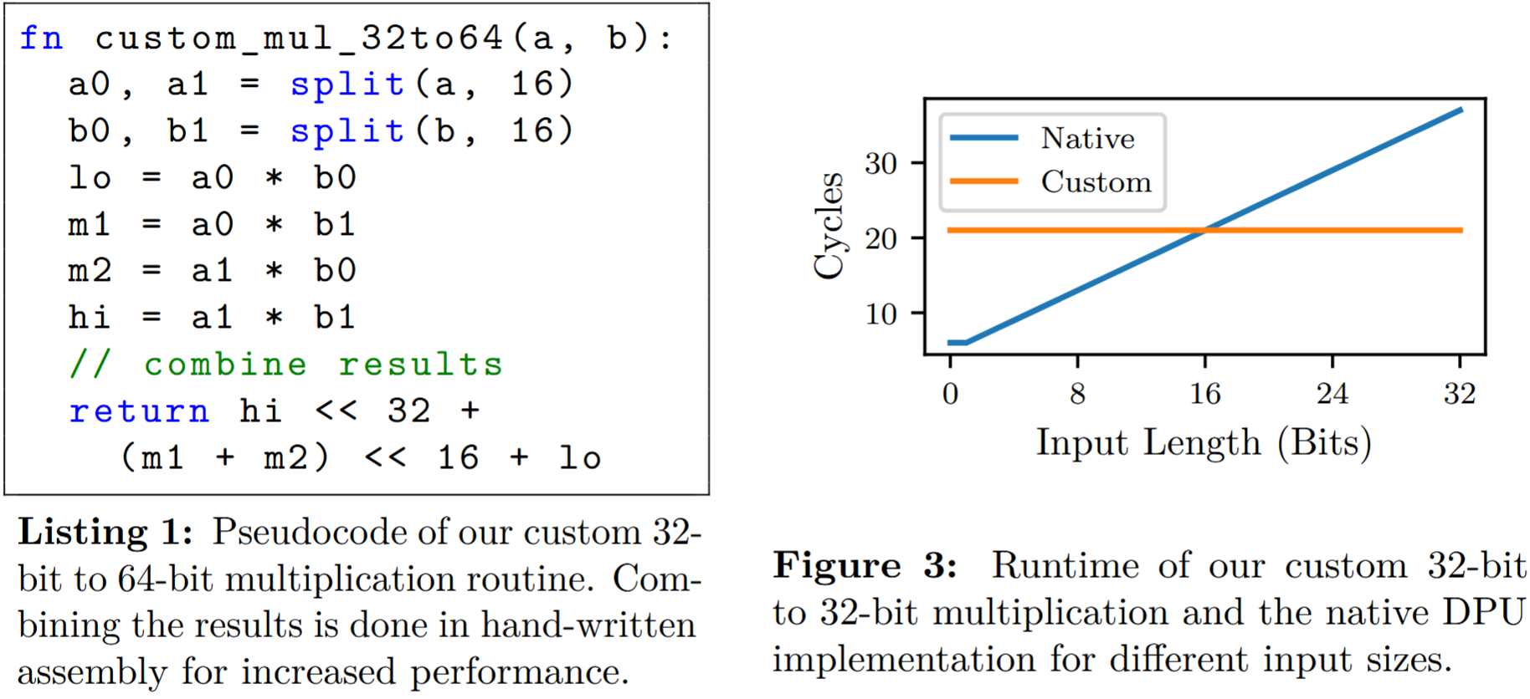
Custom Multiplication
Notes:
RNS limits to 32-bit, we still need 64-bit results for modular reduction. DPU compiler does full 64-bit multiplications. Our custom multiplication avoids this extra work.
We also have custom 32-bit mul. that only produces 32-bit results (right). Native impl. is good for small inputs, but slow in the worst case. Our custom multiplication has constant runtime instead.
Custom is faster after 16-bit. Good for our use-case; data is seemingly random (encrypted), large values are common.

Slide 18

Barrett Reduction
Goal: Calculate remainder $x$ of $v \text{mod} m$
$x=v−m⋅\left\lfloor v/m\right\rfloor$
$x=v−m⋅\left\lfloor v⋅r\right\rfloor$ with $r=m^{−1}$
$x≈v−m⋅\left\lfloor v⋅R/2^{n}\right\rfloor$ with $R=\left\lfloor 2^{n}/m\right\rfloor$

Slide 19
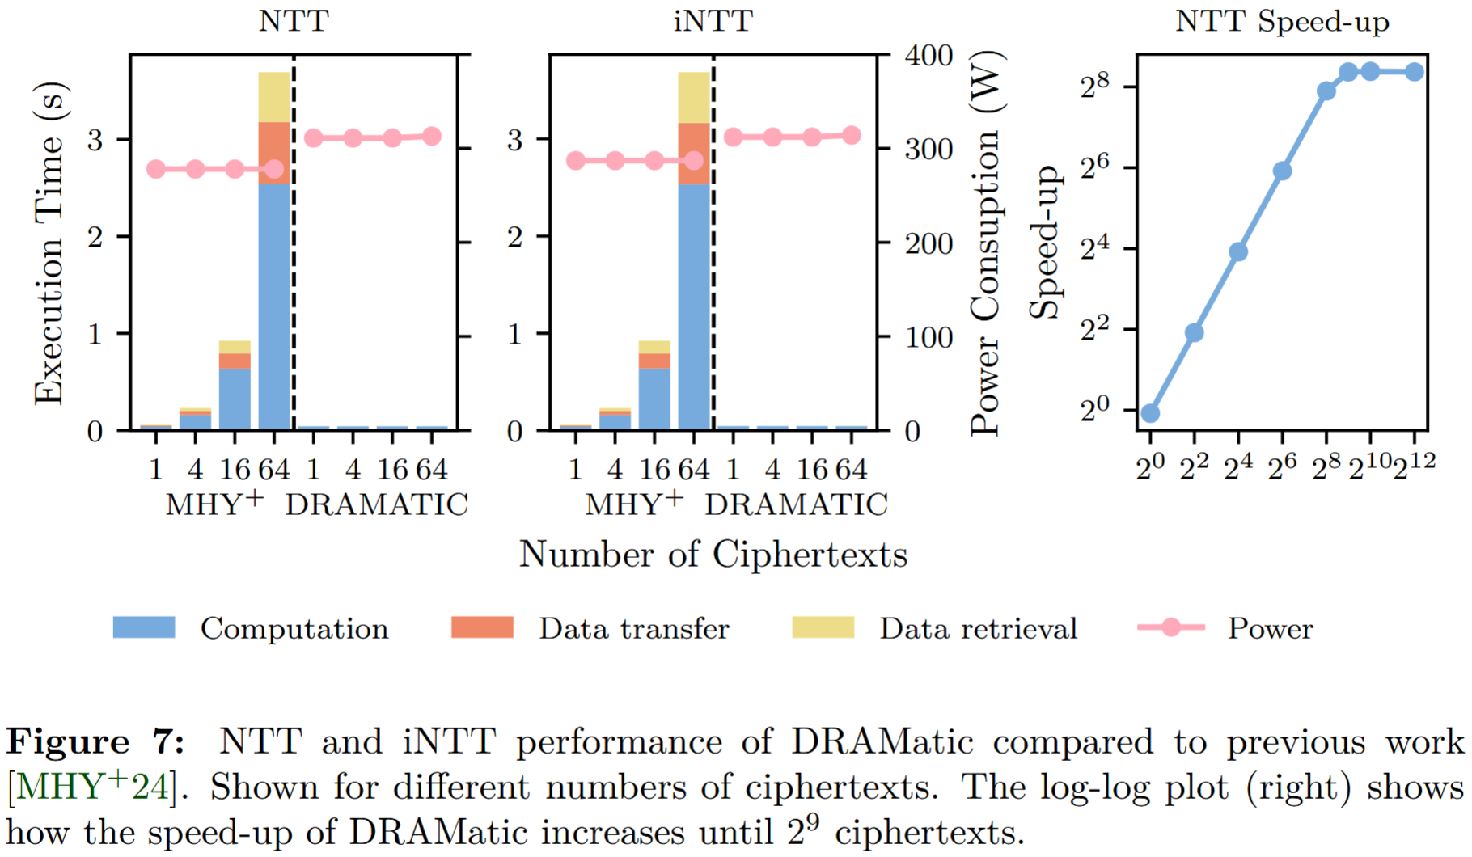
DRAMatic vs. Previous Work
Notes:
We measure computation time, but also transfer and retrieval overhead. For now, focus on computation time (blue). More realistic example later.
For a single ciphertext, times are similar. But big difference when transforming multiple ciphertexts at once.
MHY+ always uses all DPUs. DRAMatic can instead assign ciphertexts to new DPUs that were previously unutilized. The time for DRAMatic stays low as the number of ciphertexts increases, until the 128 DPUs are fully utilized.
For 512 ciphertexts and above, DRAMatic is about 334 times faster in pure computation time.

Slide 20
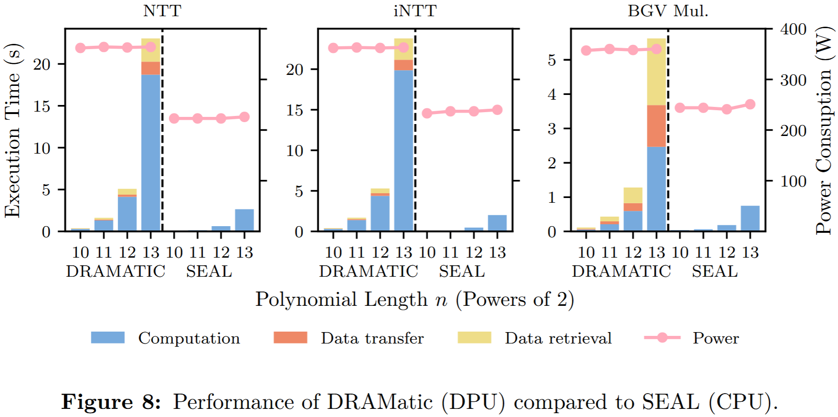
DRAMatic vs. SEAL (CPU)
Notes:
SEAL is about 7 times faster than DRAMatic in NTT (pure computation time) and 3 times faster in BGV mul. (MHY+ was about 8600 times slower than SEAL)

Slide 21
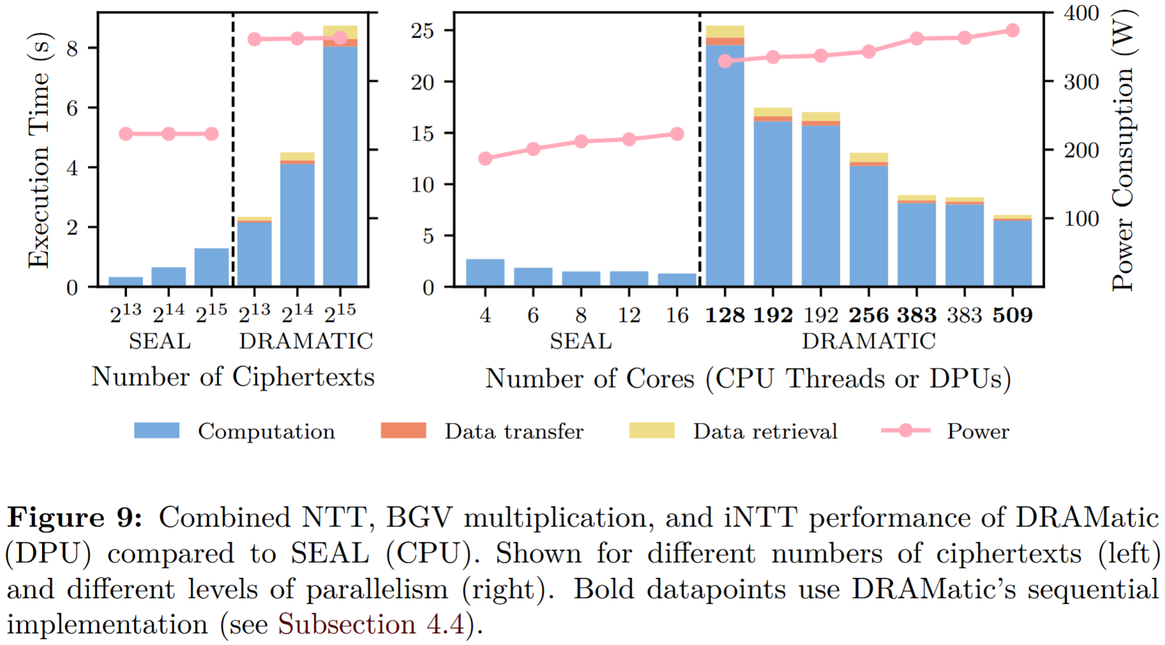
DRAMatic vs. SEAL (CPU)
Notes:
Now: Combined NTT, BGV multiplication, and iNTT operations. Transfer overhead is reduced.
But still: DRAMatic is about 6 times slower than SEAL. Also, the SEAL system uses about 38% less power.
DRAMatic has better scaling with parallelism.
From 2 to 8 DPU ranks: PIM 4 times faster, only 14% more power.
4 to 16 threads: SEAL only 2 times faster, but 19% more power.
(Maybe due to high baseline power consumption of the PIM system, cf. C-states)

Slide 22
Boosting Performance with Hardware Extensions
Major bottleneck: weak multiplication on DPUs
  Custom optimized routine still takes 21 cycles
  Modern CPUs only need a single cycle (or less, cf. SIMD)
Idea: test with fast dummy routines
  These are 9 to 10 times faster (still slow compared to CPU)
  Demonstrate potential speed-ups due to faster multiplications

Slide 23
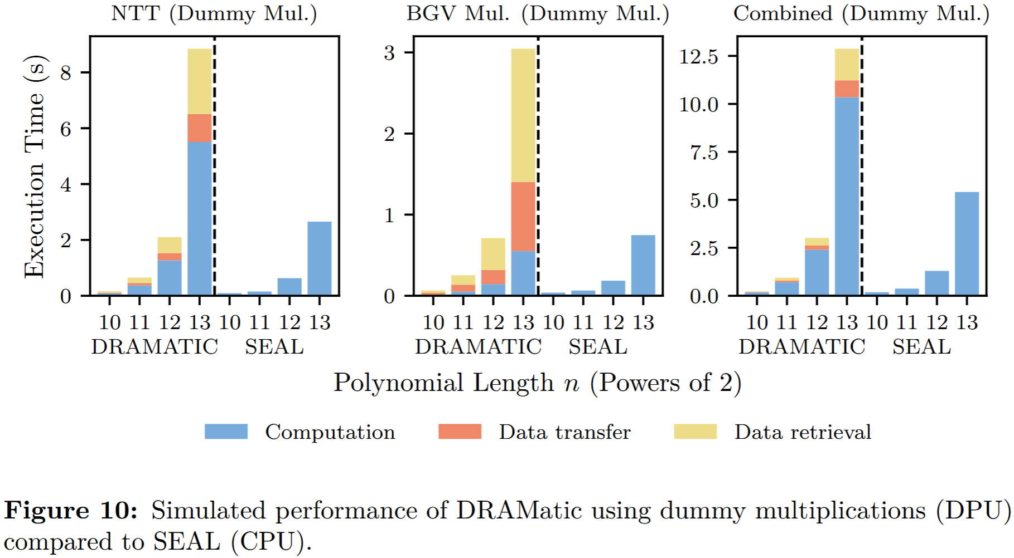
Performance with Fast Dummy Multiplications
Notes:
Around 3 times speed-up.
With dummy mul., DRAMatic is only ~2 times slower than SEAL in NTT.
In BGV mul., we even are faster in pure computation.
This shows that faster multiplication hardware on DPUs could bring great performance improvements.
However, data transfer and retrieval overheads become more significant.

Slide 24
Reducing Data Transfer Overhead
630 times reduced compared to previous work (MHY+)
Still a problem, if DPU multiplication improves
  some operations (NTT) faster for SEAL
  other operations (BGV mul.) faster for DRAMatic
Can we combine SEAL NTT & DPU BGV? (hybrid computing)
  Not possible with current UPMEM PIM!
  CPU cannot operate directly on DPU memory
  Data must be copied to/from normal DRAM and transposed
Notes:
Next slide explains transposition.

Slide 25
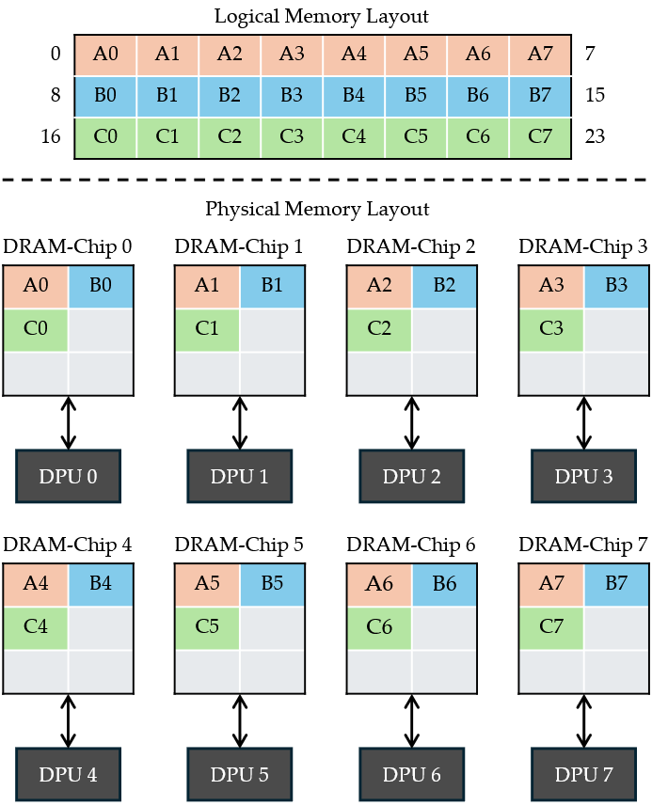
Memory Layout
Logically consecutive bytes are stored in different DRAM-chips
Transposition step performed by UPMEM SDK

Slide 26
Reducing Data Transfer Overhead
We propose a hybrid computing system
  CPU can access DPU memory directly if DPUs are inactive
  CPU can do first computation steps
  DPUs can immediately continue
CPU must finish its steps with memory transposition
  Transposition can often be combined with main computation
  No additional pass or copying
Greatly reduced transfer overhead
  PIM as “memory that can compute”
  Instead of a discrete accelerator

Slide 27

Conclusion
DRAMatic: efficient NTT and BGV mul. directly on UPMEM PIM
334 times faster than previous work
  Close the gap to SEAL (still 7x slower)
Major bottleneck: weak multiplication on DPUs
  With dummy multiplication: some operations
  faster than SEAL
Proposed hybrid computing
  Reduced transfer overhead
  Some operations on CPU, others on DPUs
Future work: 2D NTT?
Link to the paper:
arxiv.org/abs/2602.12433
Notes:
Concurrent work (2D NTT) is faster in some respects and slower in others. Maybe we can combine the best of our approaches in future work.
We are in contact but don‘t have their code yet.

Slide 28
Following: Backup Slides

Slide 29
Test Systems
PIM test machine:
  Two Intel® Xeon® Silver 4216 CPUs
  256 GB of standard DDR4 memory
  4 UPMEM PIM DIMMs: 32 GB, 8 DPU ranks, and 512 DPUs (509 usable)
SEAL test machine:
  Intel® Xeon® Gold 5415+ CPU
  128 GB of DDR5 memory

